Slide 1
CRM – View Invoice

Slide 2
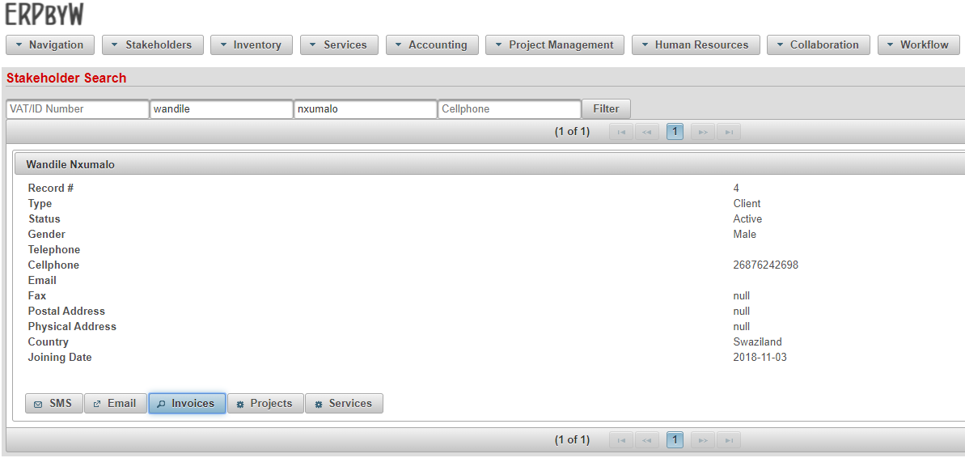
View All Customer Invoices

Slide 3
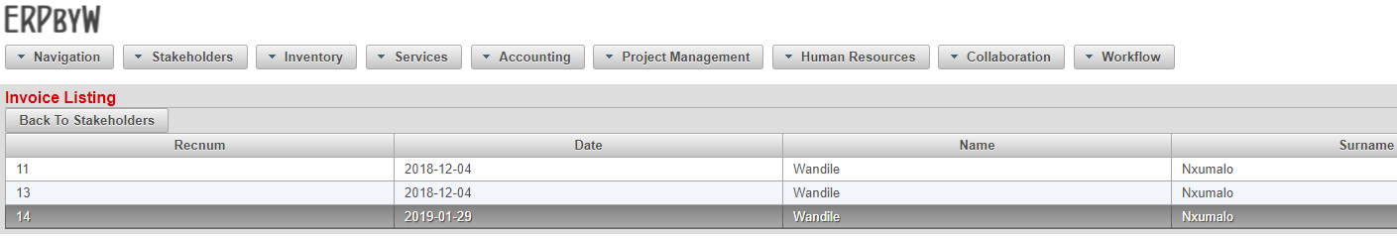
Select Customer Invoice

Slide 4
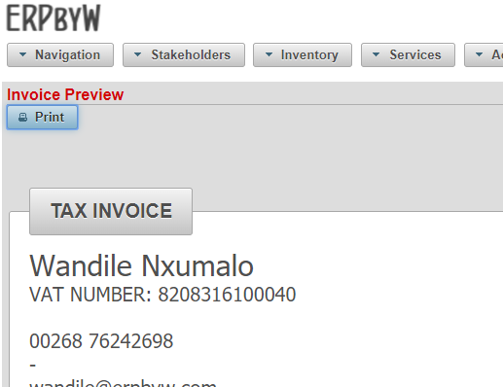
Customer Invoices is Displayed

Slide 5
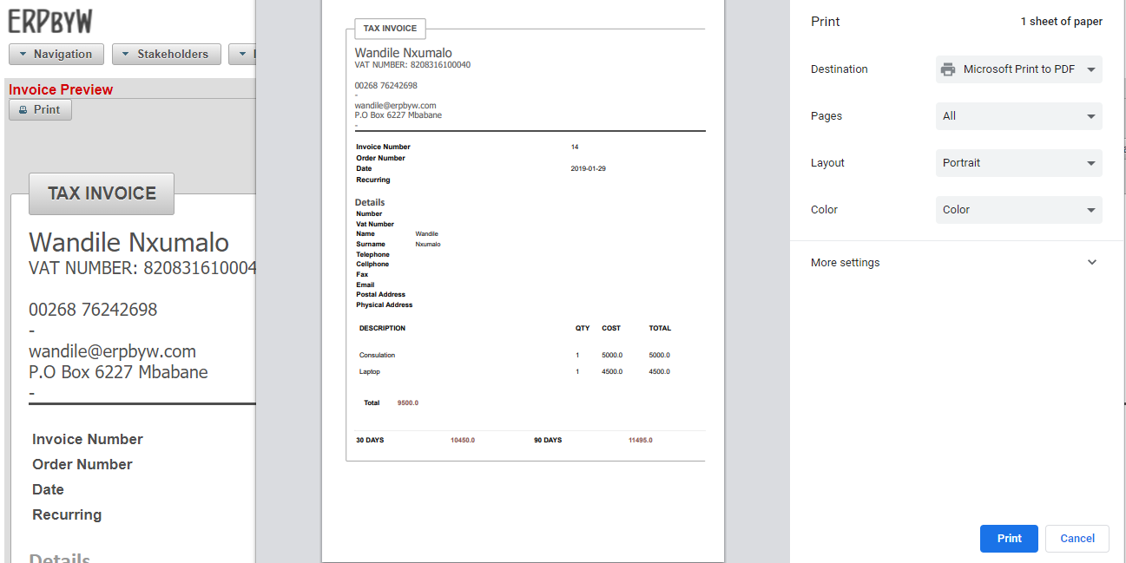
Print Invoice

